Slide 1
Project 4: Credit Card Fraud Machine Learning
Clara Richardson, Elisabeth Villarreal, Danielle Dubash

Slide 2
Agenda
01
03
Dataset Overview
Machine Learning
02
04
Data Analysis
Conclusion
Introduction to our data, methodology, and research questions
Overview of our machine learning process, training, and optimization
Visualizations and summary statistics
Discussion of findings and areas for further research

Slide 3
01
Dataset Overview

Slide 4
About our dataset
Transactions made by credit cards in September 2013 by European cardholders:
284,807 total transactions (492 fraudulent)
Classified by “Fraudulent” (1) and “Normal” (0) charges
Features V1-V28 are the principal components representing transactions obtained with PCA, the only features which have not been transformed with PCA are 'Time' and 'Amount'.

Slide 5
Research Questions
How often does a fraudulent transaction occur?
Can we predict if a transaction is fraudulent based on selected features of the transaction?
What is the average amount of a fraudulent transaction?
Approach: Logistic Regression Model

Slide 6
02
Data Visualizations

Slide 7
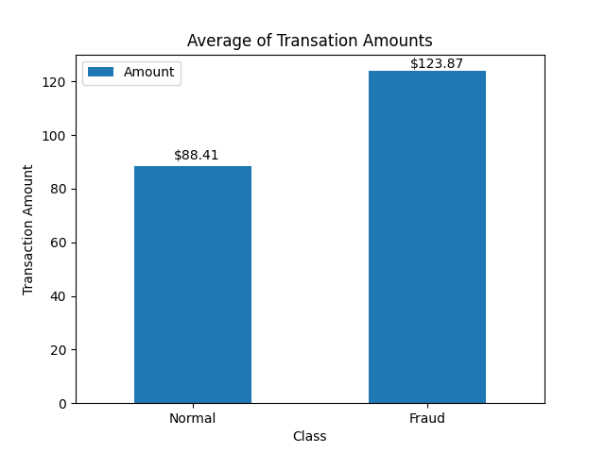
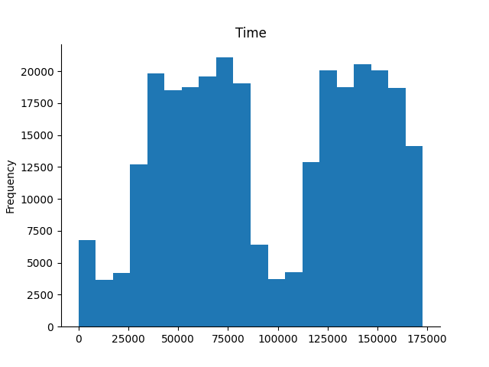
Data Analysis
INSERT VIZ
This chart represents the average amount of money spent per transaction
This chart represents the number of times a transaction happens per second

Slide 8
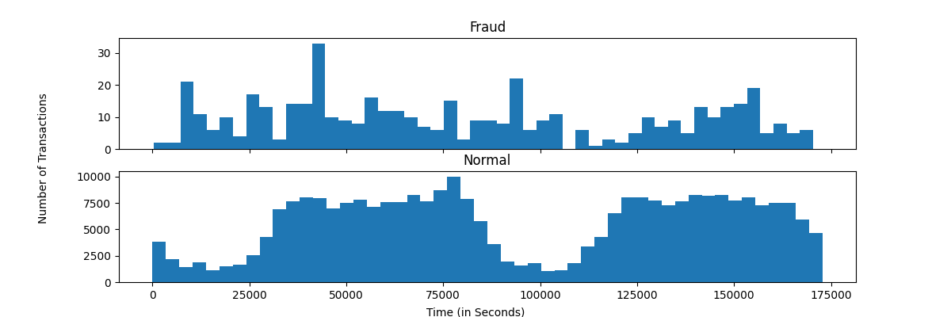
Data Analysis
Breaking out the number of transactions by time and class (fraud or normal) shows a pattern in “normal” transactions and more randomness in fraudulent transactions.

Slide 9
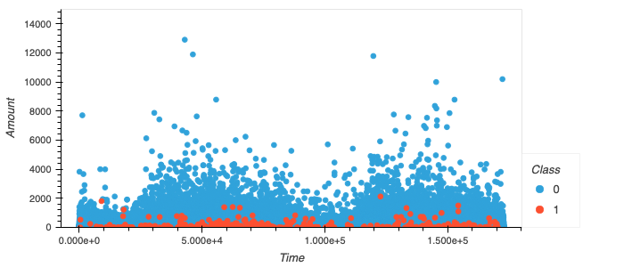
Data Analysis
This chart is a visual representation of when exactly a fraudulent charge vs True charge takes place, and with the corresponding ‘$’ amount.

Slide 10
03
Machine Learning

Slide 11
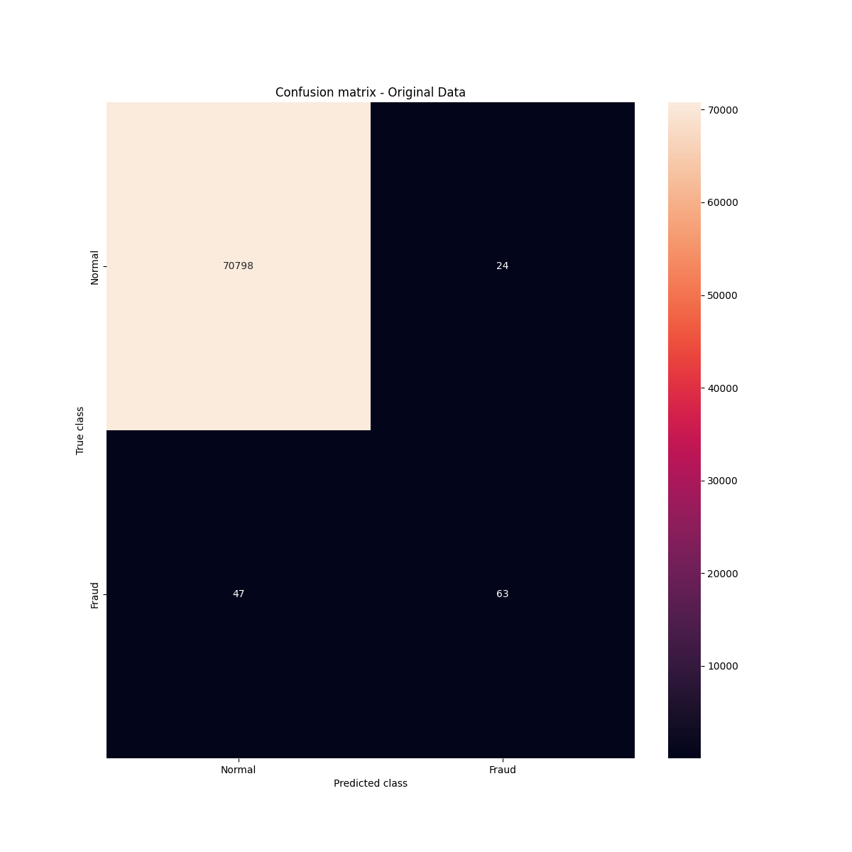
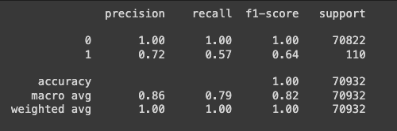
Confusion Matrix
Classification Report
The original regression shows very accurate classifications of “normal” transactions, and inaccurate classification of “fraudulent” transactions.

Slide 12
Random Oversampler
Rebalancing the data

Slide 13
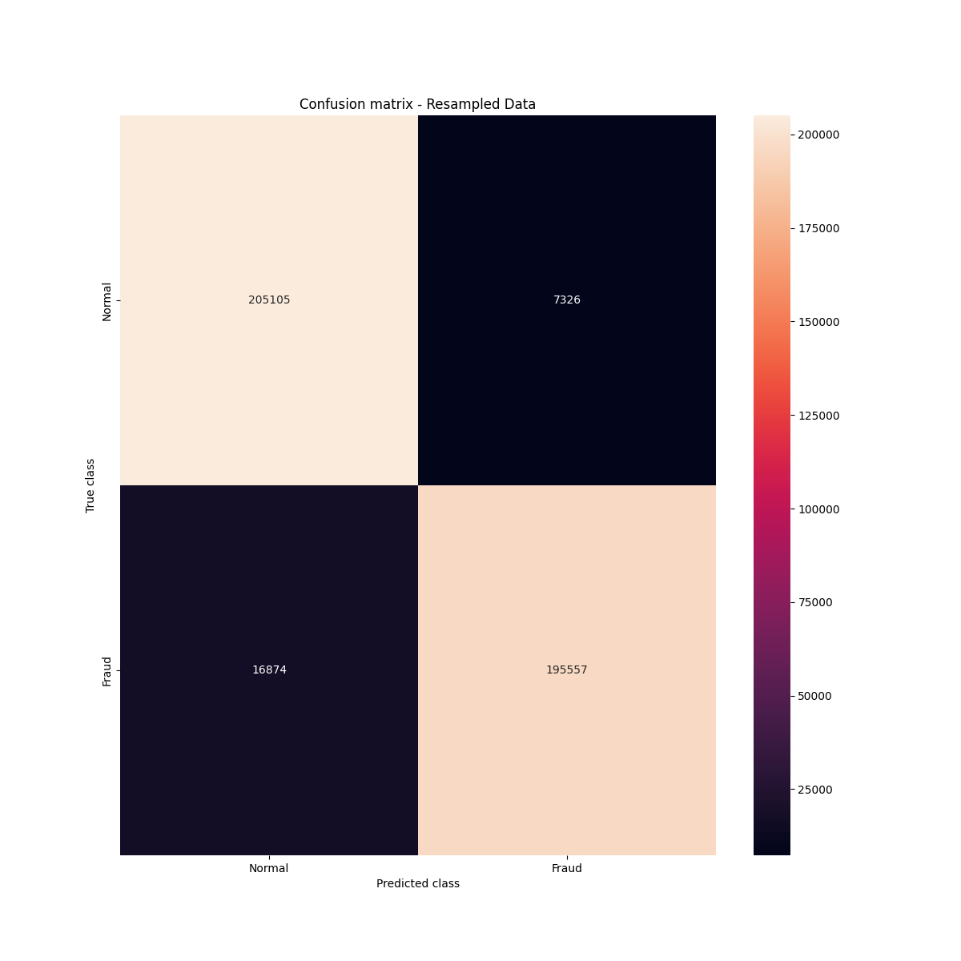
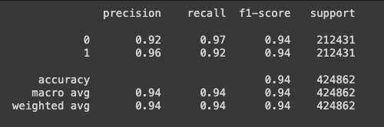
Classification Report
Confusion Matrix
Rebalancing the data improves identification of fraud, but slightly decreases the precision and recall related to normal transactions.

Slide 14
Widget Introduction

Slide 15
04
Conclusion

Slide 16
Conclusion
How often does a fraudulent transaction occur?
Fraud is much less prevalent. However, there isn’t a pattern for Fraud, but there is a pattern for regular spending habits.
Can we predict if a transaction is fraudulent based on selected features of the transaction?
Yes! :)
What is the average amount of a fraudulent transaction?
$123.87
Rebalanced Dataset
Original Dataset

Slide 17
THANKS!
Do you have any questions?
addyouremail@freepik.com
+91 620 421 838
yourwebsite.com
Please keep this slide for attribution

